Slide 1
Key stage 1 - PSHE How am I different, what makes me special?

Slide 2
We all have differences
These differences make us special in our own way
How am I different, what makes me special?

Slide 3
We all belong to the human race – but we are all different:
Our hair colour may be different
Our eye colour may be different
Some of us may be taller than others
How am I different, what makes me special?

Slide 4
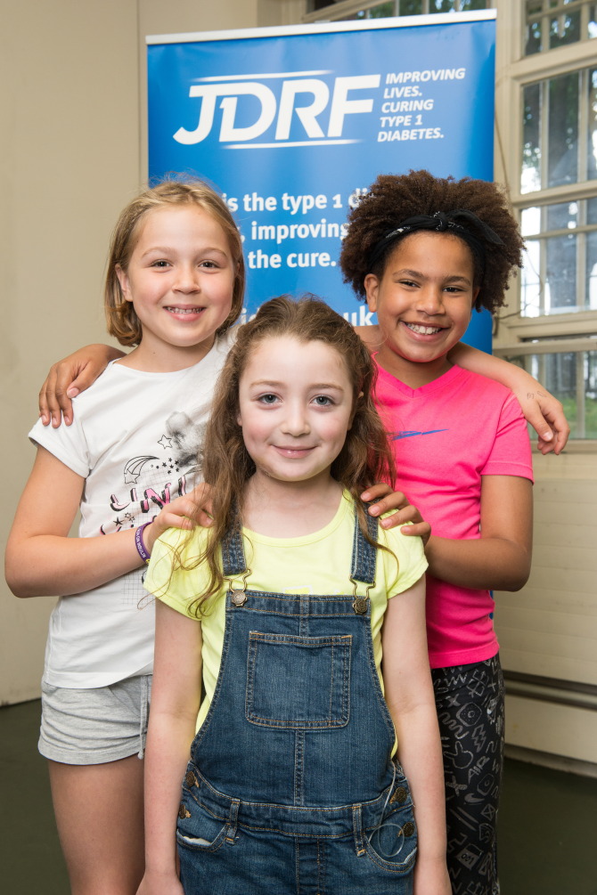
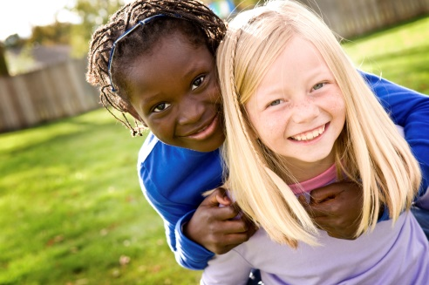
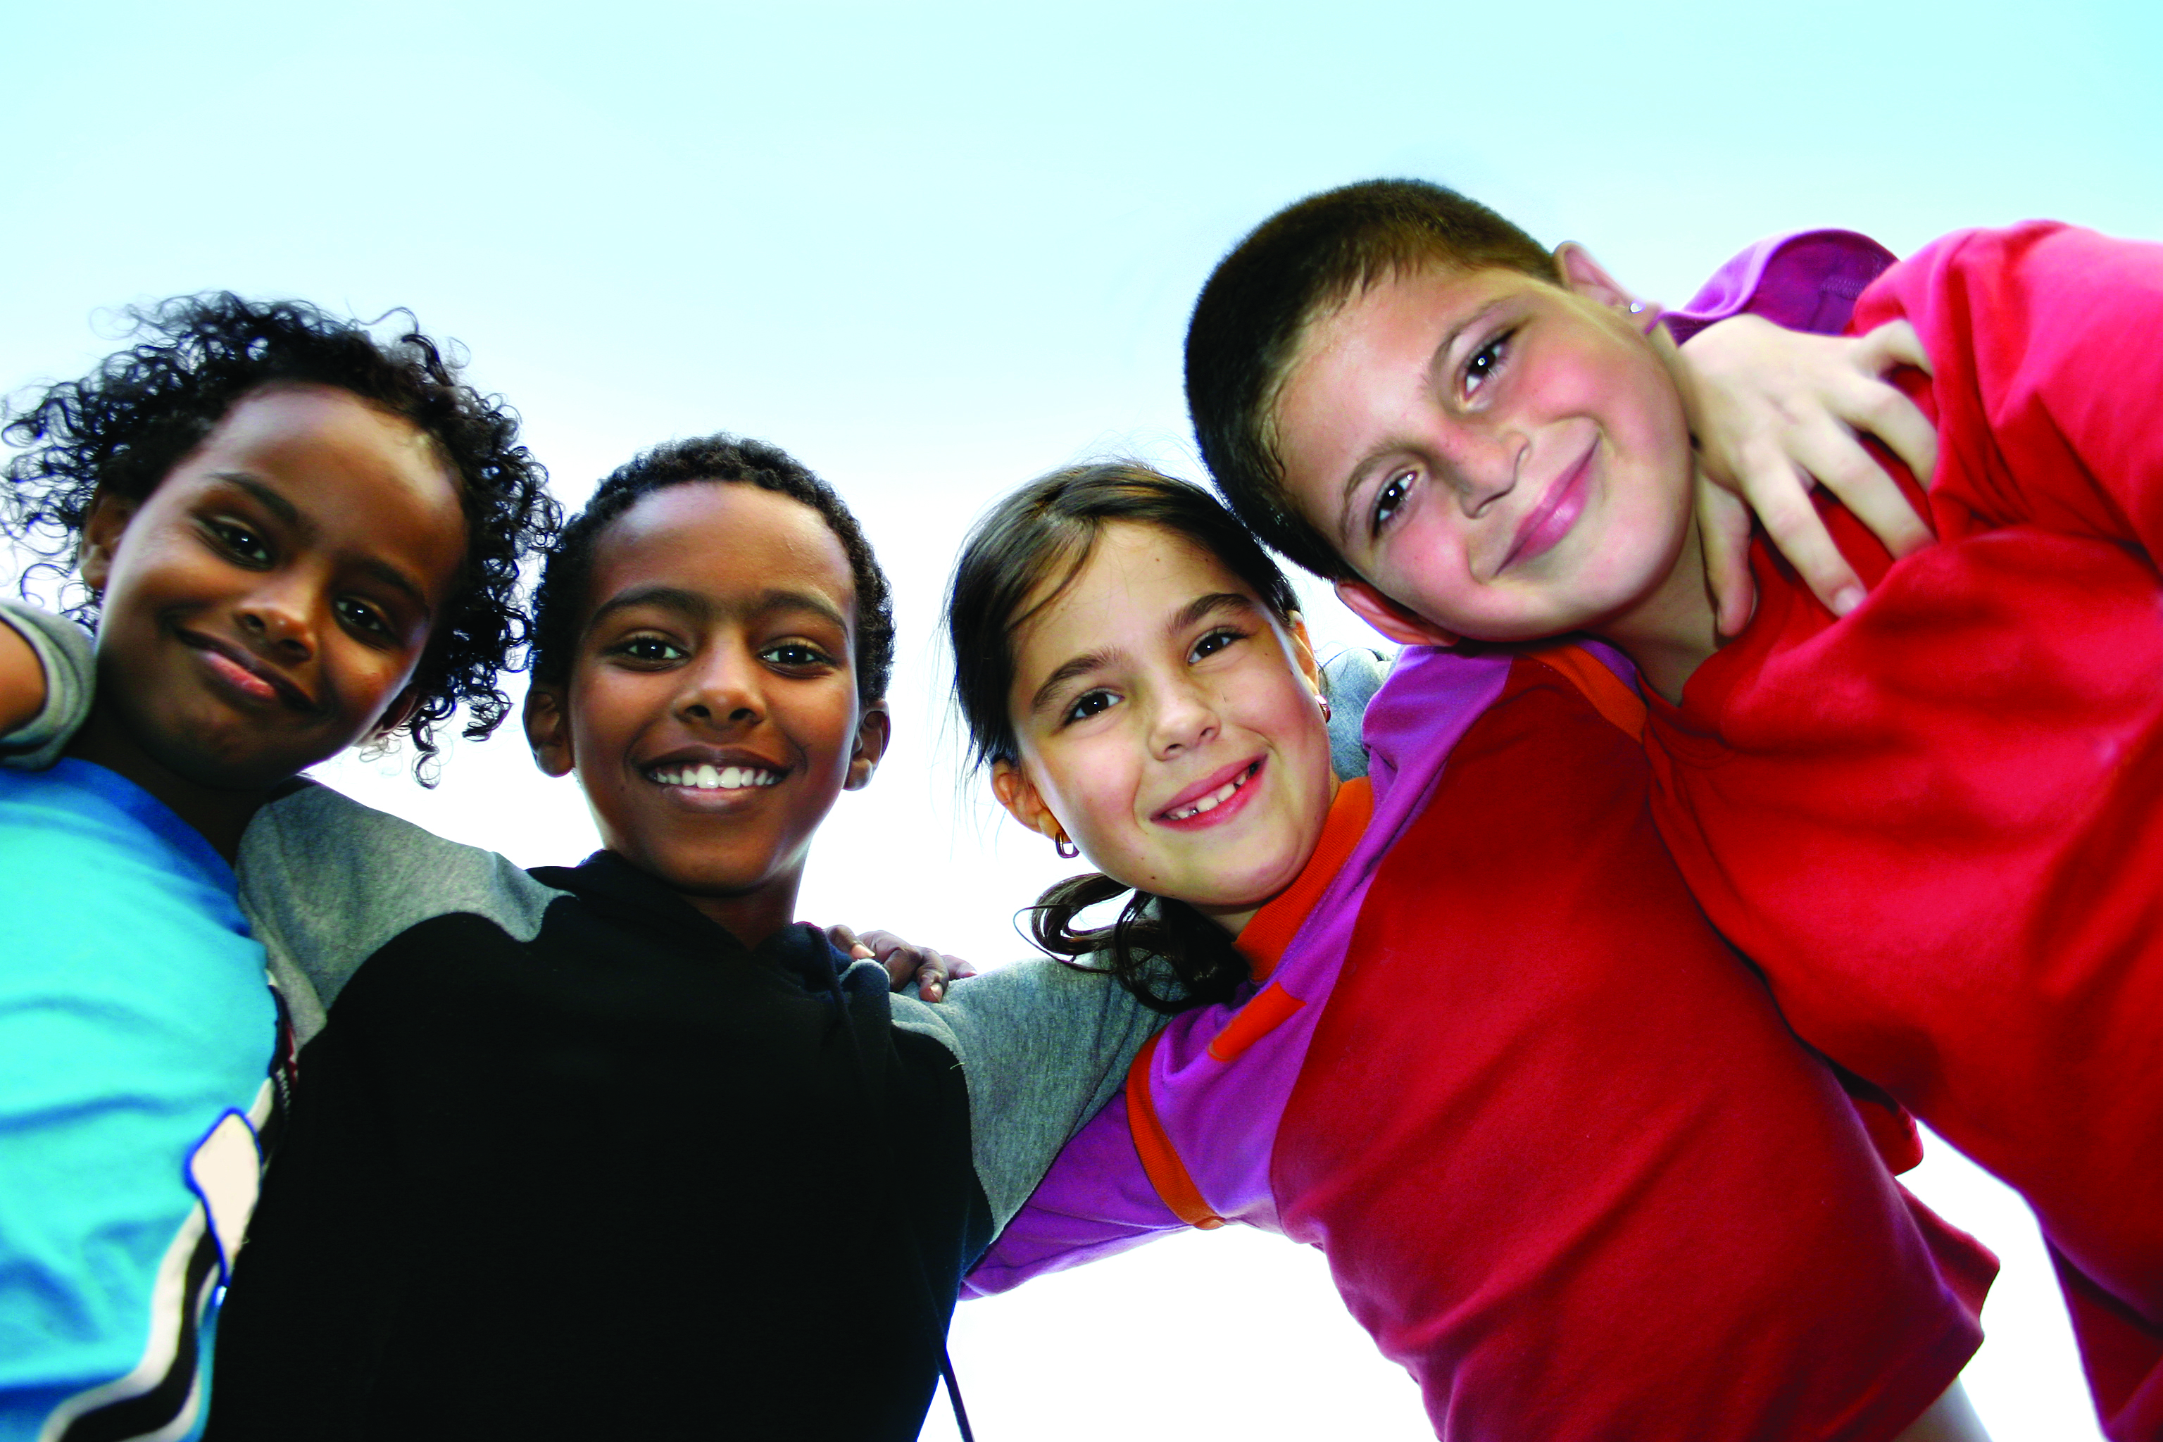
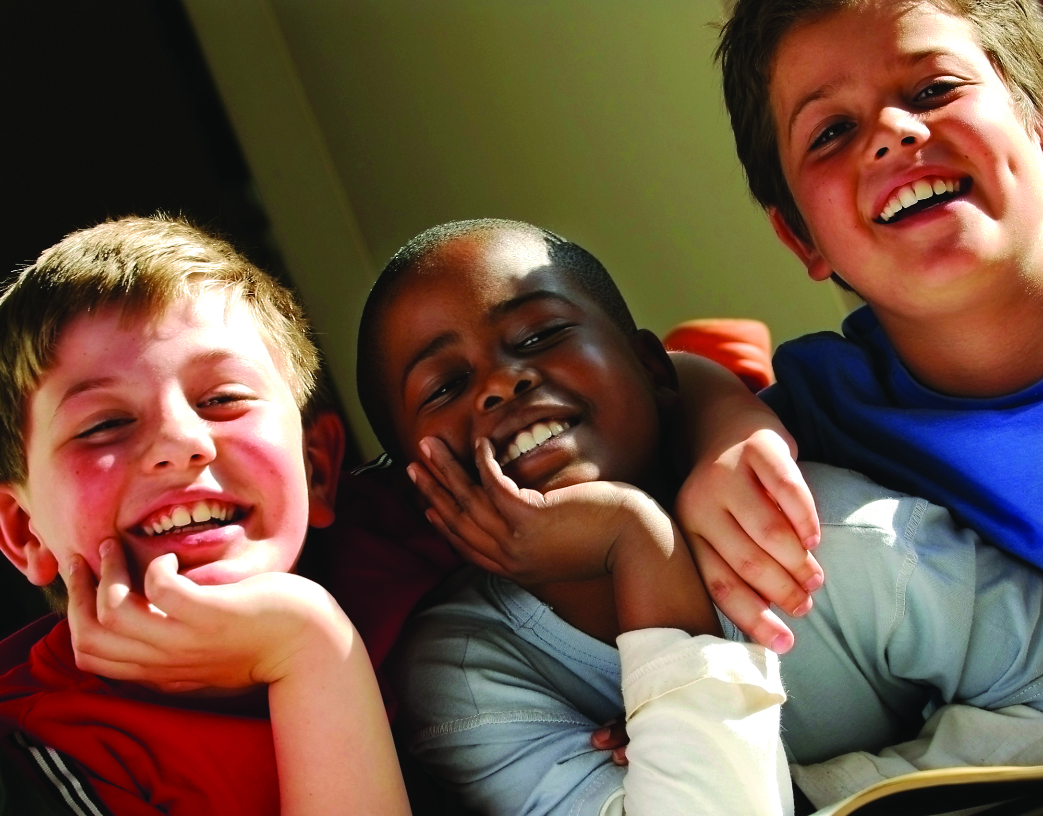
We all belong to the human race – but we are all different.
Look at these pictures.
How am I different, what makes me special?

Slide 5
How am I different, what makes me special?
Fold your arms
Who writes with their left hand?
Who writes with their right hand?
Who is ambidextrous (able to write with both hands)?
Roll your tongue
Who likes Marmite? Who likes sprouts? Who doesn’t?

Slide 6
How am I different, what makes me special?
I am good at:
Sport
Music
Listening
Being a good friend
List things here that make people in
your class special:

Slide 7
The same but different!
Talk to your partner and find three differences and three
similarities about both of you

Slide 8
The same but different!
Feedback to the class the things you find out
about your partner
Were you surprised?

Slide 9
Different on the inside
In the same way that our bodies are different on the outside, our bodies can work differently on the inside too

Slide 10
How am I different, what makes me special?
The pancreas:
Go to page 1 of Diabetes Made Simple

Slide 11
Different on the inside
Food we eat is used to make energy which our body needs to work properly
When we eat food it is broken down into sugar
The sugar then moves into the blood
A special hormone called insulin is needed to help move the sugar around the body to the cells that need it
Insulin is made in the pancreas

Slide 12
What makes us special?
Use what you found out about your partner to:
make a wrist band or card for your partner using words to describe why you think they are special
or draw a picture and add labels to say why your partner is special

Slide 13
What makes us special?
I / my partner
Write(s) left handed
Have / has blue eyes
Don’t / doesn’t like marmite
Can roll my / their tongue
I am / my partner is good at:
Sport
Music
Listening
Being a good friend

